Slide 1

8) Discriminant Analysis and Classification

Slide 2



Applications:
-A soft drink manufacturer is interested in understanding the demographic and psychographic differences among drinkers of Coke, Pepsi, and Dr. Pepper.
-A bank needs to decide whether to issue a loan to a customer and is concerned whether the customer will default or repay the loan.
-A segmentation study was conducted to identify strategically meaningful groups. The study involved 1000 respondents. The client is interested in classifying the entire customer database into the derived segments.

Slide 3
Discriminant analysis is primarily concerned with description and summarization of group separation. Linear functions of the original variables are used to describe group differences.
Objectives include determining the optimal dimensions to best illustrate group differences, and identifying the relative contribution of variables regarding group separation.
The standard discriminant analysis method common in practice is attributed to Ronald Fisher.
Classification is concerned with prediction or allocation of cases to groups. Objective is to optimally assign new cases to groups.
In practice, the term discriminant analysis is often applied to classification also, and one approach is to use the results from discriminant analysis for classification (Fisher’s classification approach). But other classification methods we will cover are commonly used as well.

Slide 4
Basic Idea
Suppose we have data (income and age) on purchasers(P) and nonpurchasers (N) of a particular product.
Age
p
p
p
p
p
p
n
p
n
n
n
n
n
n
Income

Slide 5


Basic Idea
Suppose we have data (income and age) on purchasers(P) and nonpurchasers (N) of a particular product.
Age
p
p
p
p
p
p
n
p
n
n
n
n
n
n
Income

Slide 6
D = b1 Age + b2 Income

Slide 7

In discriminant analysis, a function(s) or dimension(s) is derived to maximally separate the groups
Age
p
p
p
p
p
p
n
p
n
n
n
New dimension
n
n
n
Income

Slide 8
Two Group Discriminant Analysis
The Discriminant Analysis Function
D = b_{o} + b₁X₁ + b₂X₂ + …+b_{k}X_{k}
Where D=discriminant score
bj=discriminant coefficient or weight
Xj=predictor or independent variable
Analysis assumes that each group is a sample from a multivariate normal population, and all populations have the same dispersion.

Slide 9
Basic Steps in a Discriminant Analysis
-Formulate the problem
Identify objectives, criterion and predictor variables
-Estimate the discriminant function coefficients
Determine the coefficients that produce the largest separation.
-Determine the significance of the function
-Interpret the results
Interpretation of coefficients is similar to that in multiple regression
-Assess validity
Check prediction using hold-outs

Slide 10
Example:
A firm is interested in description and prediction/classification of employee job category (Sales, Brand Management, Mkt. Research) based on a test that scores individuals on the following dimensions: Managerial, Social, Quant.
A sample of 180 was obtained for the analysis, and saved as file Job_Category.data_.sav.
We’ll start with just the Sales and Brand Management groups (2 group discriminant analysis)

Slide 11
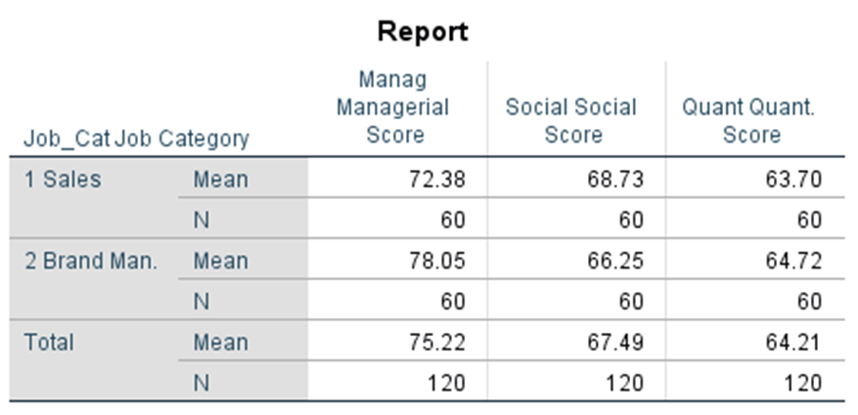
Starting with basic descriptive statistics for groups 1 and 2 (Sales and Brand Management)

Slide 12

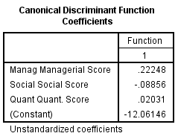
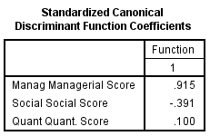
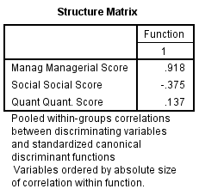
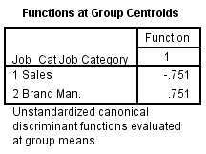
P-Value for test of Ho: The centroids of the groups are the same
What is the discriminant function?
How would you use the discriminant function to classify an employee with the following scores: Manag=70 ,Social=67 , Quant=58 ?

Slide 13
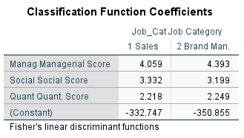
Note: You can also request classification functions as an equivalent way to classify cases (each group will have an associated function, assign a case to the group with the largest classification function value)

Slide 14
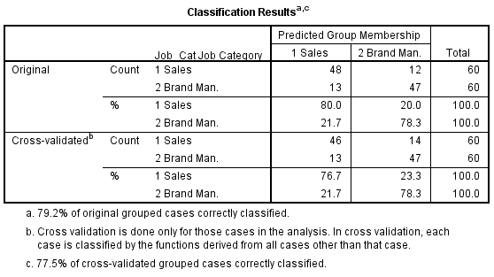
Validation Results

Slide 15
Multiple Discriminant Analysis: Extending to three (and more) Groups
With G groups and k predictor variables, it is possible to estimate up to the smaller of G-1 or k functions
The first discriminant function will have the largest separation. The second function will have the second largest separation, and be uncorrelated with the first. And so on.

Slide 16
Extending our example to include the third group (Mkt. Rsh.)
First, looking at basic descriptives using SPSS Compare Means procedure

Slide 17
For Discriminant Analysis in SPSS click Analyze, Classify, Discriminant
Put in the independents (manag, social, quant) and grouping variable (job_cat), and define the range (1,3).
Click Statistics and under Function coefficients click unstandardized, continue
Click Classify, summary table, leave-one-out classification,
Combined-groups, continue
Click Save, Discriminant Scores, Predicted group membership, Continue, Ok

Slide 18
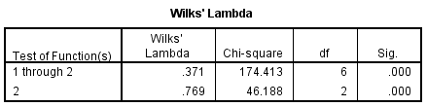
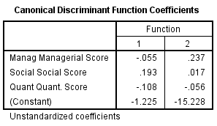
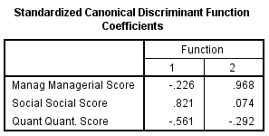
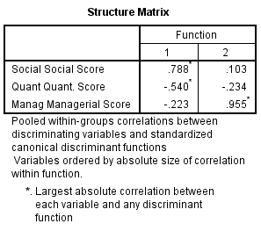
How would you interpret the two functions (dimensions)?
To get a plot, Under classify, plots, click combined-groups

Slide 19
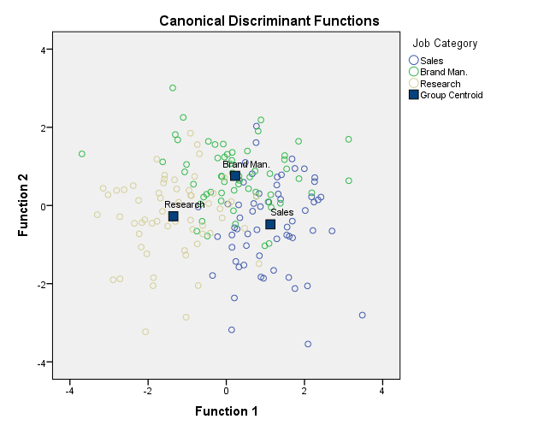

Slide 20
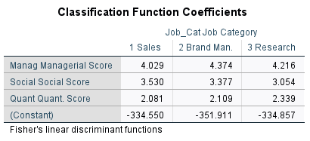
With 3 groups there will be 3 classification functions

Slide 21
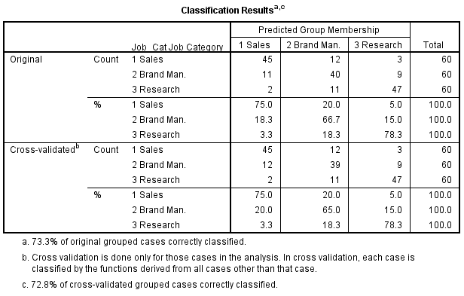

Slide 22
Added Application 1)
A researcher is interested in understanding differences among drinkers of, Pepsi(1), Coke(2) and Dr. Pepper(3). A study obtained information about cola preference, age, income, and responses to a likert type scale question measuring degree of innovation. Data is contained in file cola.sav.
a) Obtain a discriminant analysis, perform tests on the function, and provide an interpretation.
b) Obtain a plot of the discriminant scores.
c) Perform Fisher’s classification analysis and assess the performance of the classification functions.
Added Application 2)
Recall the beverage cluster analysis from the last topic. Use Fisher’s classification analysis as a validation of the K-Means solution.

Slide 23
SAS Code
proc import datafile=‘C:\JobCategoryData.sav' DBMS=SAV OUT=jcd;
run;
proc discrim data=jcd can crossvalidate out=outcan;
class Job_Cat;
var Manag Social Quant;
run;
/* The can option specifies Fisher's (canonical) functions */
/* The outcan dataset contains the discrim scores on the discrim
Functions (Can1 and Can2) */
/* The following produces the discrmim plot */
proc sgplot data=outcan;
scatter x=can1 y=can2/datalabel=Job_Cat;
run;

